Slide 1

Student, Transferee Enrollment Processing System
Lauren Brian L. Sy
Ronnelo A. Mernilo
Rian Christopher F. Segarra

Slide 2


DO YOU KNOW?

Slide 3



P R O B L E M
#TransfereeProblems

Slide 4

S O L U T I O N

Slide 5




S O L U T I O N

Slide 6

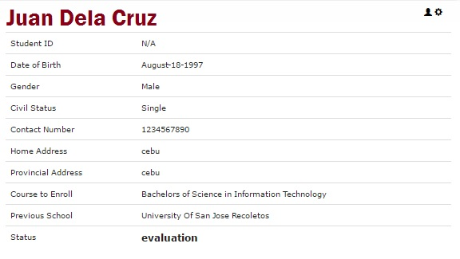
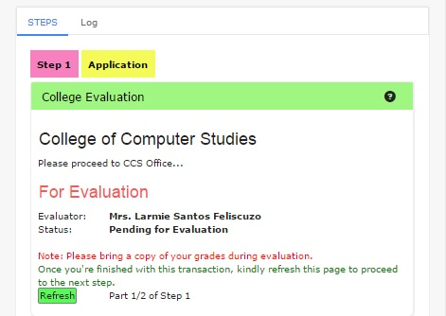
F E A T U R E S

Slide 7


F E A T U R E S

Slide 8


B E N E F I T S
=

Slide 9
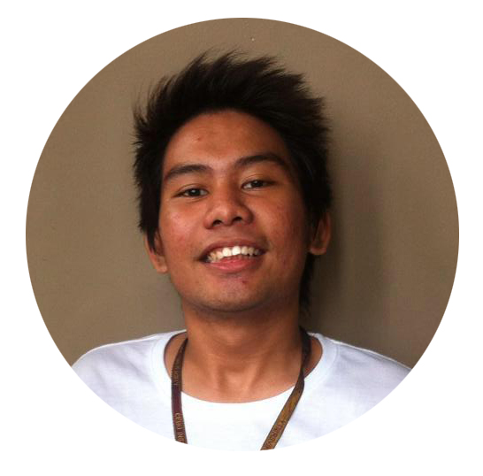
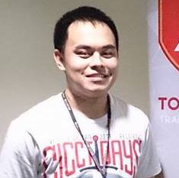

Rian Christopher F. Segarra
BSIT - 4
Lauren Brian L. Sy
BSIT - 4
Ronnelo A. Mernilo
BSIT - 4

Slide 10


